Slide 1
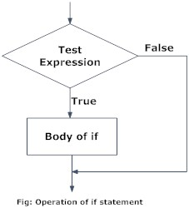
A control statement is a statement that determines whether other statements will be executed. An if statement decides whether to execute another statement, or decides which of two statements to execute. A loop decides how many times to execute another statement.
Sequence
Control Statements
Selection/decision making statements
loop
Sequence
it is one by one execution of a program.
selection
based on some condition program execution depends.
if
Syntax
if (condition) :
statement
a=int(10)
if a>0:
print(" the number a=" + str(a) + " is greater than zero")

Slide 2
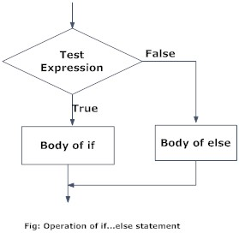
if.. else..
Syntax
if (condition) :
statements
else:
Statements
a = 200
b = 33
if b > a:
print("b is greater than a")
else:
print("b is not greater than a")

Slide 3
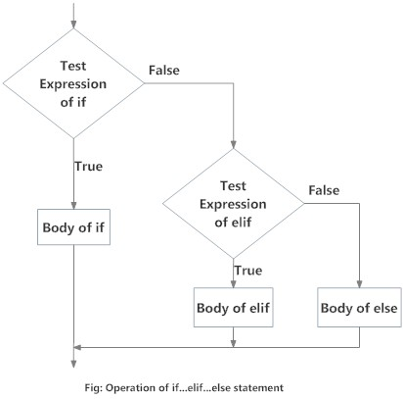
elif..
syntax
if (condition):
statement
elif condition:
statement
.
.
.
else:
statement

Slide 4
a = 200
b = 33
if b > a:
print("b is greater than a")
elif a == b:
print("a and b are equal")
else:
print("a is greater than b")

Slide 5
nested if
Syntax
if condition:
statement
if condition:
statement
else:
statement
else:
statement
eg:
num = float(input("Enter a number: "))
if num >= 0:
if num == 0:
print("Zero")
else:
print("Positive number")
else:
print("Negative number")

Slide 6
Task:
Write a program to print given number is divisable by 7 `
Write a program for following statement
a) read a age
b)check for minor if age should be less than 18
d)check for major if age is between 18 to 60
e)check for senior citizen
3.to check given number is negative or not
4.Given number is even or not
5.to check bigger of three numbers
3.Write a program for eligibility age for working in government
4. Write a python program for
a)input a number
b)check for negative number and further check for its two digit negative number

Slide 7
Task 1
num=int(input("Enter the number!..."))
if(num%7==0):
print(i)
Else:
print(“not divisable by 7”)
Task 3
age = int(input(" Please Enter Your Age Here: "))
if age > 18:
if age >= 18 and age <= 60:
print(" You are Eligible to Work ")
else:
print(" You are too old to work as per the Government rules")
print(" Please Collect your pension!")
else:
print(" You are Minor ")
print(" You are not Eligible to Work ")

Slide 8
Task 4
num = int(input("enter the number!.."))
if (num < 0):
print("negative Number")
print("Now i am checking for two digit negative number!.....")
if (num>=-99):
print("Two digit Negative Number")
else:
print("It is not a two digit negative number!...")
else:
print("Positive Number")
#nested if

Slide 9
Task:
a=int(60)
if a<18:
print('minor')
elif (a>=18) and (a<=59):
print('major eligible for voting')
elif a>=60:
print('senior citizen')
else:
print('give correct no')

Slide 10
age=int(input("enter the age:"))
weight=int(input("Enter the weight:"))
if(age>=18):
print("u have passed the first rule.. since u r having age is greater than 18")
print("now u r eligible to test for weight...")
if(weight>=50):
print("u passed second rules..sice u r having weight is larger than 50")
print("Go to hall number 210 to donate blood!....")
else:
print("u r not heathy!.. better luck next time!...")
else:
print("u r not eligible to donate blood since u r minor!...")
print("thank you")

